Slide 1
Exploratory data Analysis
By
Richa Singh

Slide 2
Outline
Introduction to the Raw House dataset
Data Preparation
Data Exploration
Visualization
Summary

Slide 3
Introduction to the Raw House dataset
Raw house dataset is the geospatial dataset as it contains features like zipcode, longitude and latitude.
The dataset is a continuous dataset which clearly takes any value within a range and has infinite number of possible values.
The dataset contains 5000 rows and 16 columns
It has got float, integers and object variables.

Slide 4
Data Preparations
Uploaded the raw house dataset excel file on the google drive.
Used the modules os, drive, numpy, pandas,matplotlib and seaborn in google colab notebook.
Read the first five rows of the dataset to verify if the data load was successful.
Identified the duplicates and null values.
Dropped the column which were irrelevant like kitchen features, floor covering.

Slide 5
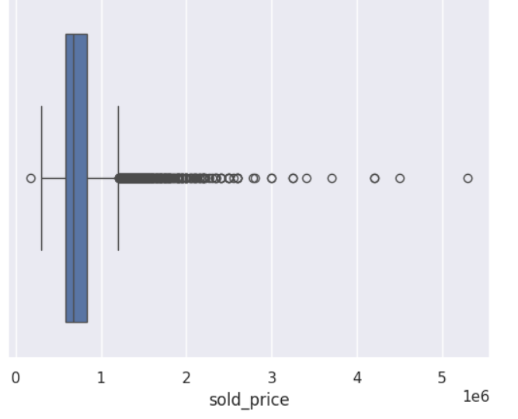
Data Exploration
By using the method of EDA(Exploratory data analysis), I have found out the outliers in the dataset.
An outlier is a point or set of points that are different from other points. Sometimes they can be very high or very low. It's often a good idea to detect and remove the outliers
Outliers can be error in data or unusual value for some other reason.

Slide 6
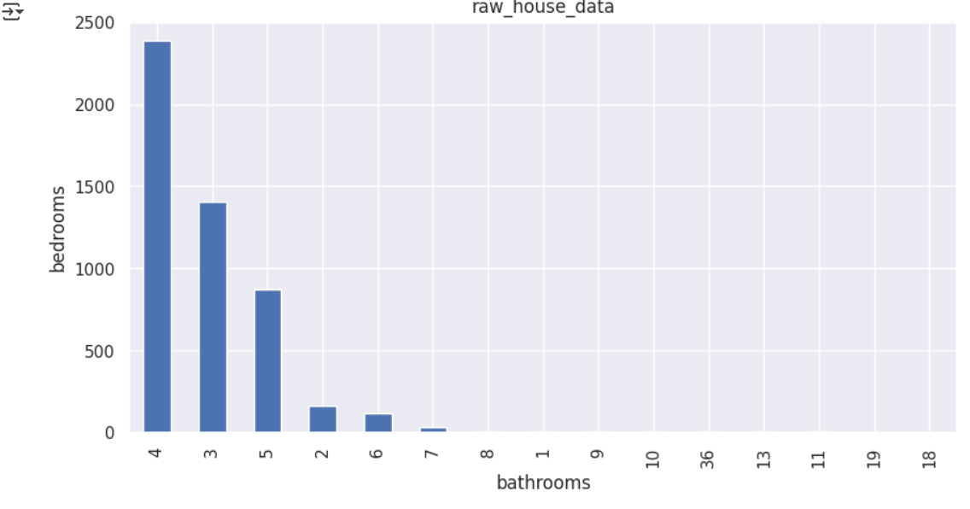
Visualization
A histogram is a graphical representation commonly used to visualize the distribution of numerical data.
This histogram is clearly representing bedrooms on the x and bathroom Y axis respectively, which shows that maximum number of bedrooms and four bathrooms

Slide 7
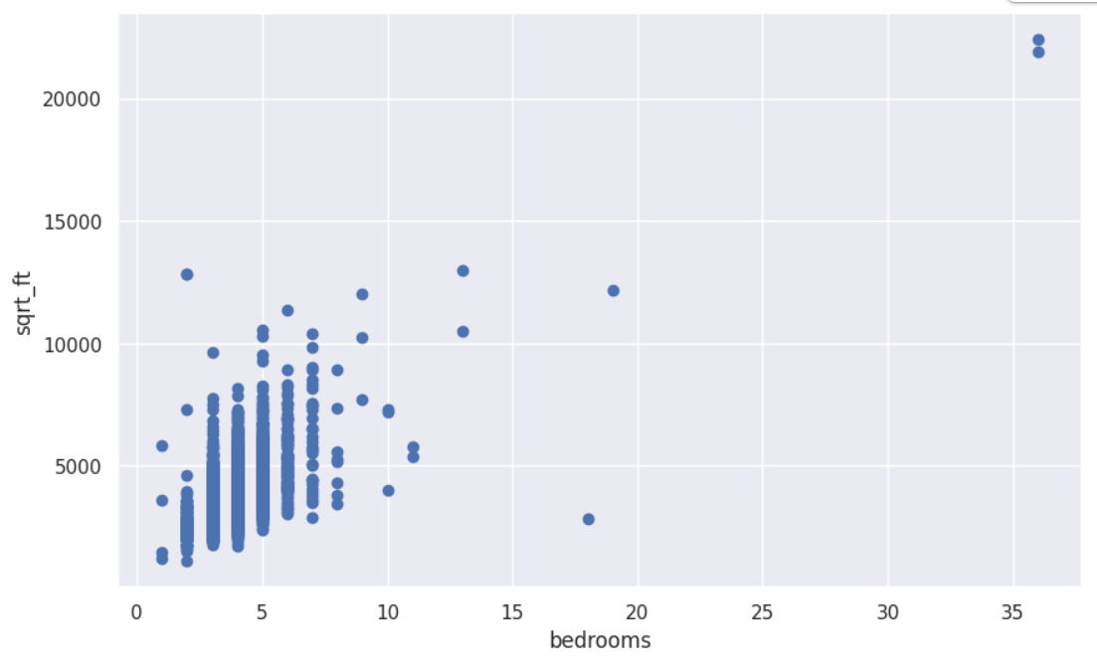
Scatterplot
Scatterplot is displayed sqrt.ft and bedrooms on x and y axis respectively.
In the displayed scatterplot bedrooms are grouped by sqrt.ft. Essentially 10000 square feet has 5 to 8 bedrooms.

Slide 8
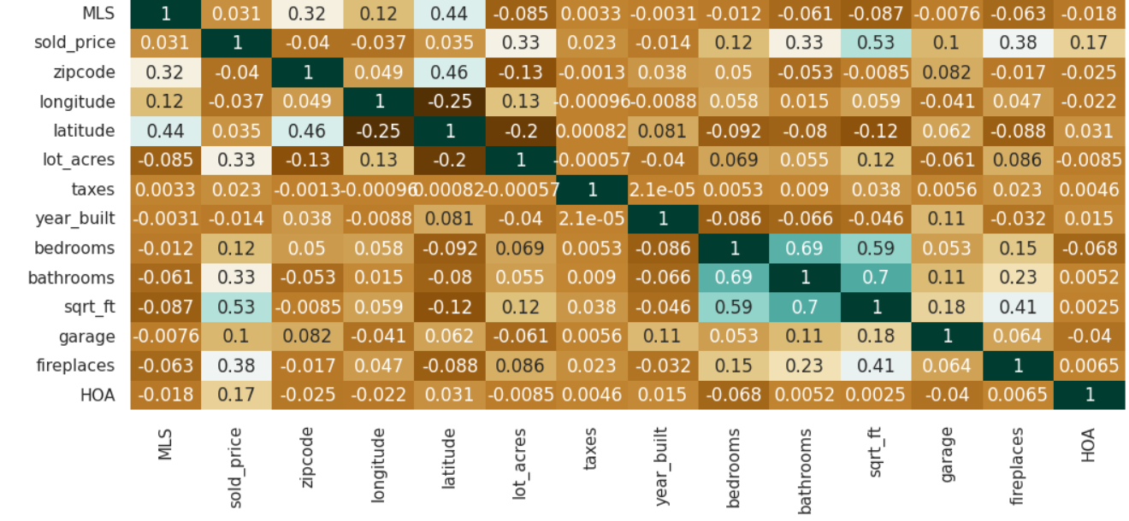
Correlation Matrix
Correlation matrix display the correlation coefficient between each variable in a dataset.
Attributes with the negative values are least correlated and the one near to 1 are highly correlated

Slide 9
Summary
It is geospatial and continuous dataset.
Various method has been used like box- plot, scatter plot, and correlation matrix in exploratory data analysis.
Boxplot has represented the outliers and errors in the dataset
Scatterplot has displayed the two numeric variable on x and y axis to draw a line .
Correlation matrix has displayed the coefficients that measure the strength and direction of relationship between variables.

Slide 10
Thankyou

